Slide 1

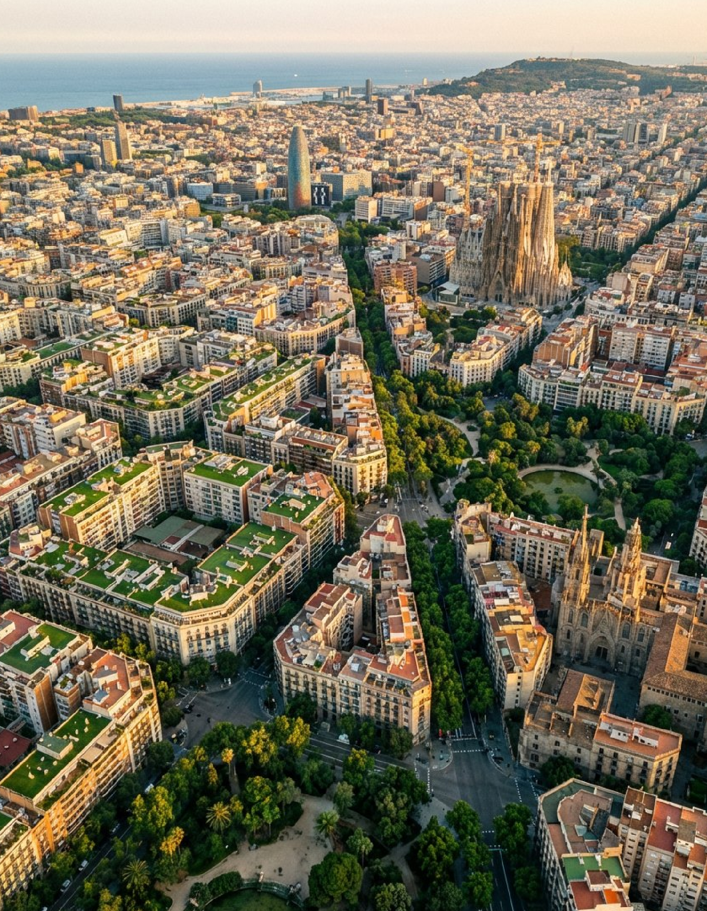






WGIC26 – World Green Infrastructure Congress
Barcelona & Lleida, Spain
Shaping the Future of Green Infrastructure in Cities
October 27-30, 2026

Slide 2
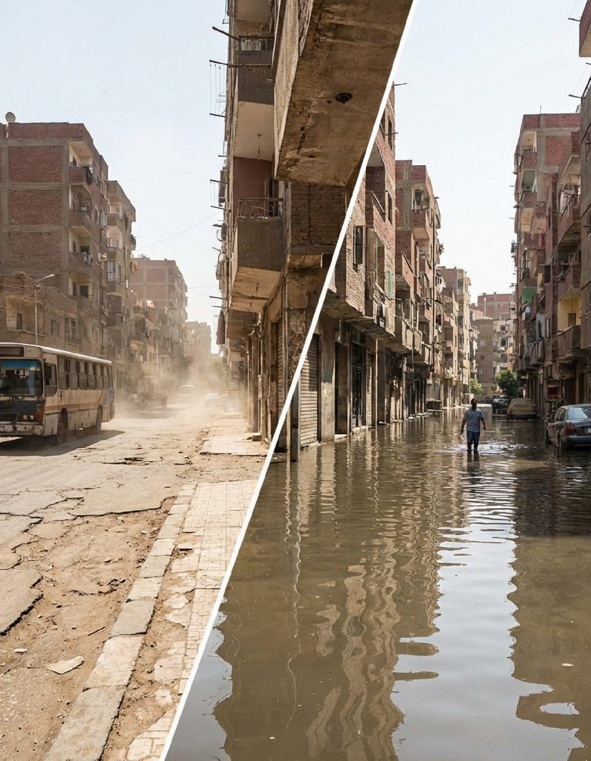
Cities Are Facing Unprecedented Environmental Challenges
Cities around the world are facing major environmental pressures:
  Climate change
  Urban flooding
  Heat islands
  Biodiversity loss

Slide 3
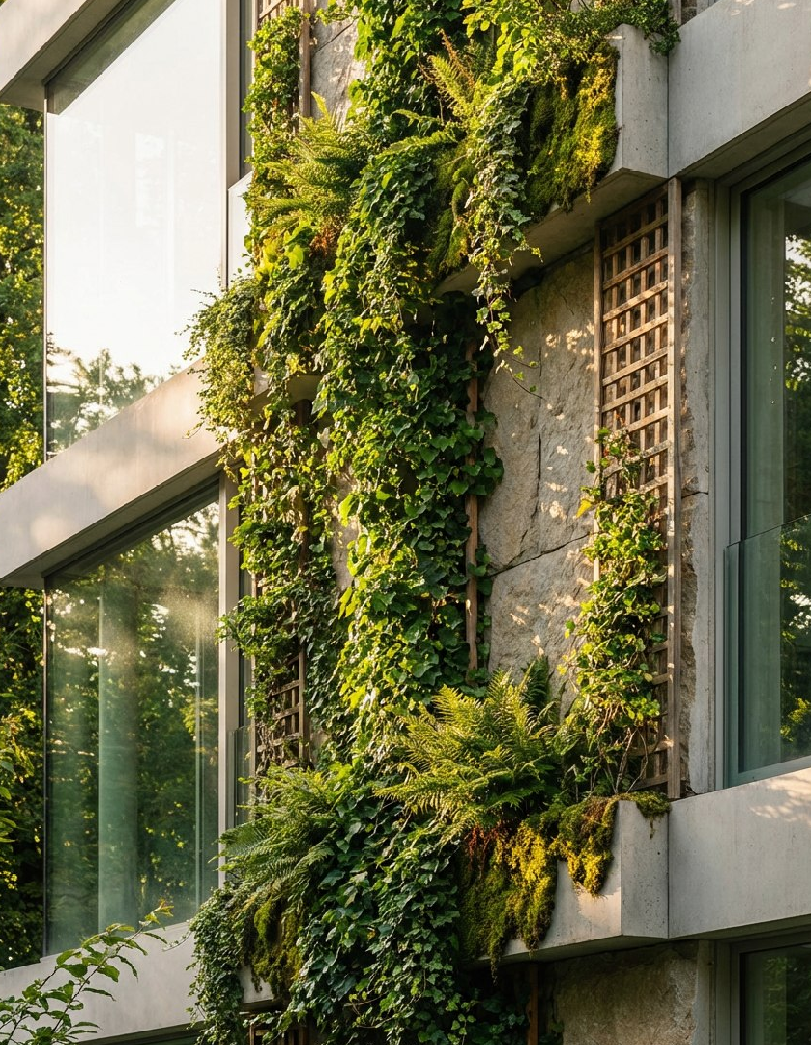
A Rapidly Expanding Green Infrastructure Market
Key facts:
  The European Green Deal mobilizes hundreds of billions of euros in climate investment
  The EU Biodiversity Strategy 2030 promotes nature-based solutions
  Cities across Europe are investing heavily in urban resilience
Example investment areas:
  sustainable urban drainage systems
  green roofs and walls
  urban biodiversity infrastructure
  climate-adapted public spaces

Slide 4
A Global Platform for Green Infrastructure
A Highly Specialized International Audience
Typical audience distribution:
  45–55% academia and research
  20–30% private sector
  15–20% public sector
The World Green Infrastructure Congress brings together:
  leading researchers
  city governments
  engineering firms
  environmental agencies
  infrastructure companies
Key sectors represented:
  engineering
  construction
  urban planning
  landscape architecture
  water management
Key facts:
  international participation
  attendees from more than 30 countries

Slide 5
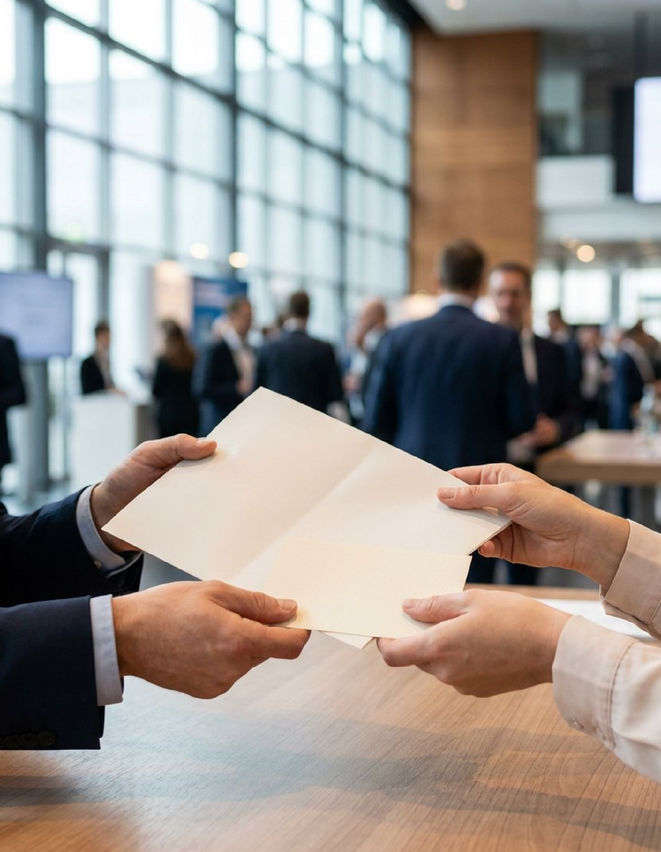
Who Attends WGIC
Participants typically include:
  city planners
  environmental agencies
  infrastructure engineers
  architects and landscape architects
  researchers and policy experts
  urban technology providers

Slide 6
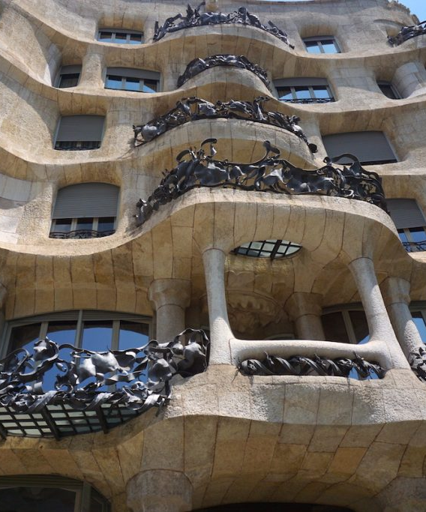
Why you cannot miss Barcelona WGIC26
  Gaudi’s Year
  Barcelona World Architecture Capital
3 Interactive Workshops
Global South: Designing the green infrastructures of the Global South through a genuine partnership based on mutual learning, co-creation of knowledge, and equitable benefit sharing.
Health and Well being: Connecting health and green infrastructure sectors. Designing to connect with nature (biophilia criteria) and avoiding the negative impact of the lack of nature.
Post conflict and Disaster Recovery: How can green infrastructure contribute to social and environmental recovery after crisis situations due to conflicts or disasters.

Slide 7
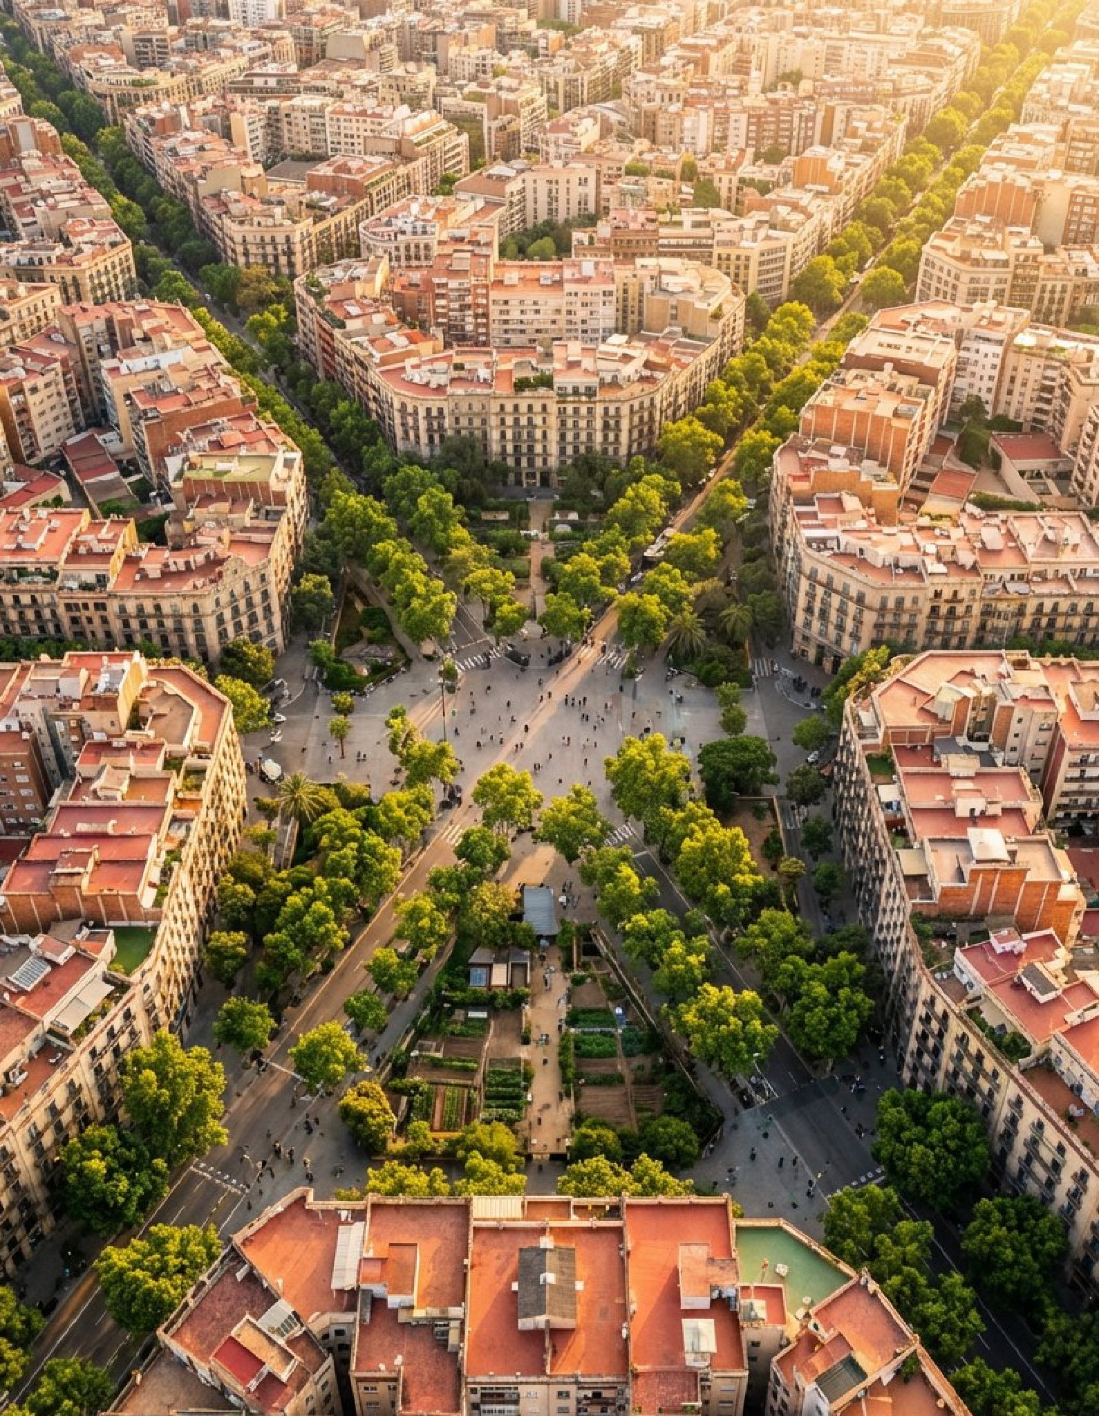
Barcelona: A Living Laboratory for Sustainable Cities
Barcelona is recognized globally for leadership in:
  urban planning
  sustainable mobility
  climate adaptation strategies
  nature-based solutions
Key initiatives include:
  Superblocks (Superilles)
  Barcelona Nature Plan 2030
  Blue-green infrastructure initiatives

Slide 8
Why Companies Sponsor WGIC
Multiple Opportunities for Interaction
Benefits:
  Positioning as a leader in sustainable infrastructure
  Access to international decision-makers
  Opportunity to present technologies and projects
  Business development and partnerships
Sponsors gain visibility through:
  plenary sessions
  sponsored panels
  exhibition booths
  networking receptions
  gala dinner
  technical visits

Slide 9
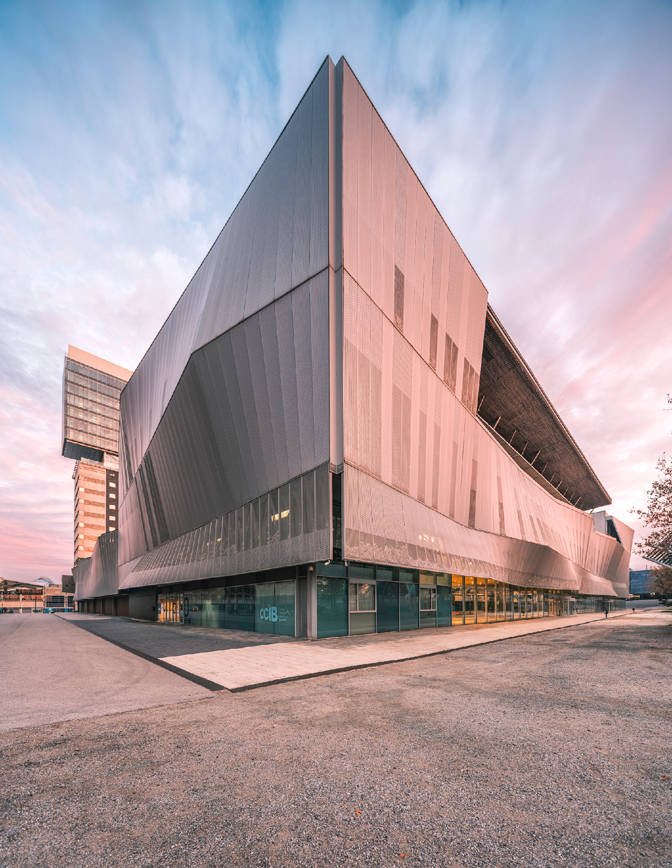
Brand Visibility for Sponsors
Examples:
  stage branding
  exhibition presence
  program branding
  website promotion
  digital marketing exposure

Slide 10







Sponsorship Packages
CATEGORY
DIAMOND (EXCLUSIVE)
EMERALD
PLATINUM
GOLD
Investment
€30.000
€15.000
€10.000
€6.000
Congress passes
15 Full Passes
10 Full Passes
5 Full Passes
2 Full Passes
Gala dinner tickets
10 Tickets
5 Tickets
2 Tickets
1 Ticket
Speaking opportunity (*)
TBC
TBC
TBC
TBC
Naming rights
Main Auditorium
Parallel Room
---
---
Brand placement
Maximum (Global)
High Visibility
Standard
Digital Only
Included stand
Premium (Large 4*4m)
Mid-size (3*3m)
Compact (pod 2*2m)
---
(*) Speaking opportunities are subject to availability and the Organizer's final confirmation

Slide 11
Sponsorship Add-ons
ITEM
PRICE
AVAILABILITY
Gala Dinner Naming Rights
€20.000
1 (Exclusive)
Official Congress App
€10.000
1 (Exclusive)
Lanyards & Badges
€8.000
1 (Exclusive)
Coffee Break Sponsor (per day)
€5.000
4 available
Technical Tours (BCN or Lleida)
€6.000
4 available
Full-page Ad in Proceedings
€2.000
Unlimited
Produced Video Interview
€2.500
10 slots

Slide 12


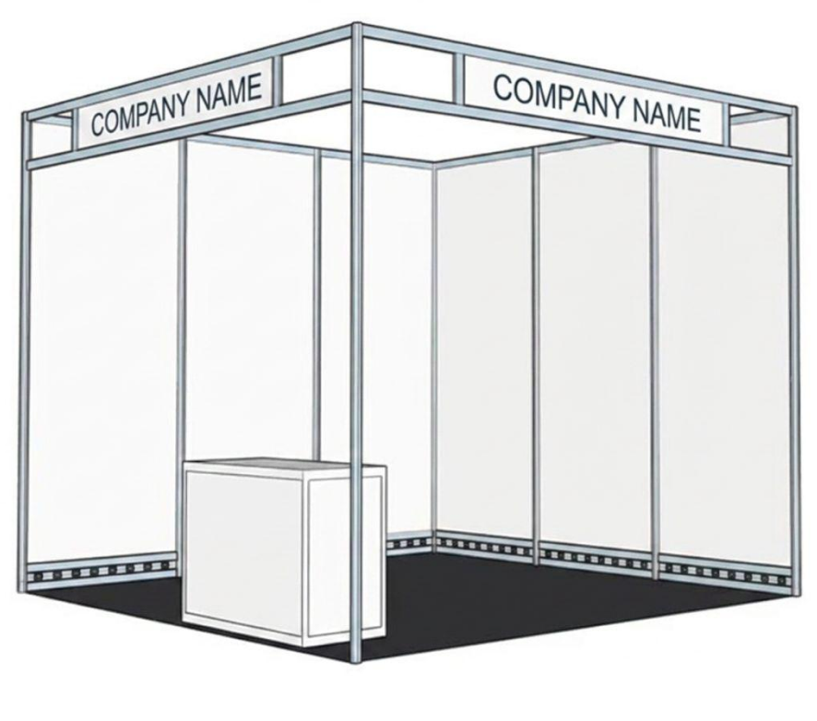
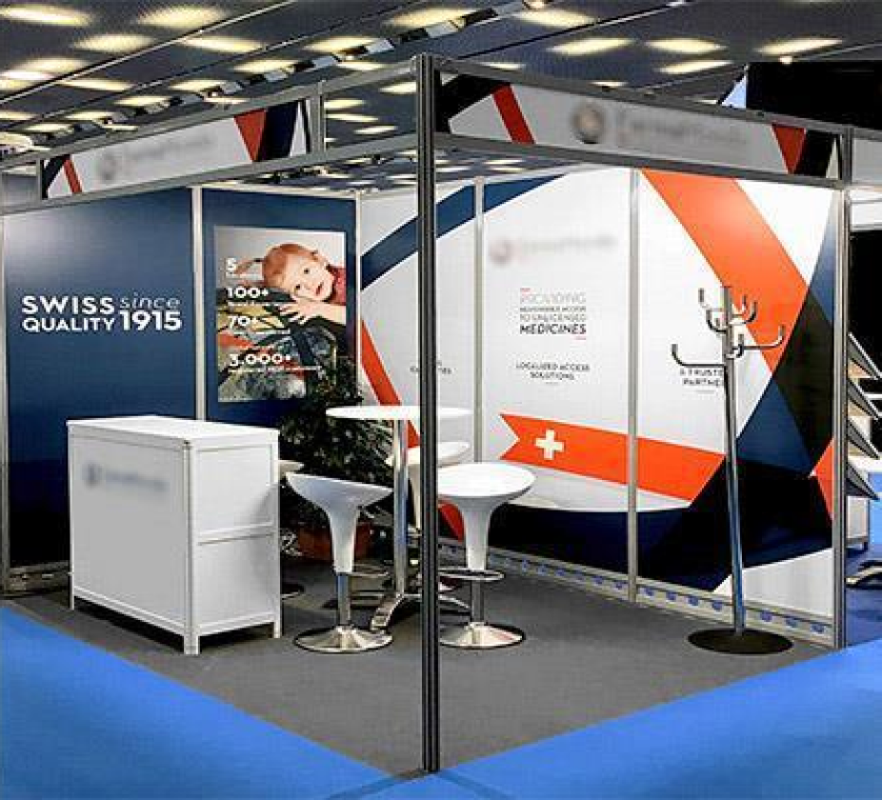
Exhibition Opportunities: The WGIC Garden
A turnkey solution for a seamless and high-impact presence.
Our exhibition area is designed to be the vibrant heart of the congress. To maximize networking, all congress lunches and coffee breaks will take place within the Expo Zone, ensuring a constant flow of delegates and high visibility for every exhibitor throughout the day.To simplify logistics, all stands are managed and produced directly by the venue’s official providers, offering a professional, unified, and hassle-free experience.
Shell Scheme.
Final furniture to be defined.
If the company wishes, they can upgrade the basic equipment or signage included in the price. This can be checked directly with the venue and the organizers
1. Garden BIG (Premium Stand)
The best choice for market leaders seeking maximum visibility in the exhibition area.
Space: Large format exhibition stand 4 m x 4m
Format: Fully produced "Turnkey" solution with a unified high-end design.
Included Services: LED strip lights., information desk (counter), electricity (3,3kW electrical switchboard (1 socket available), high-speed Wi-Fi, pre-inauguration cleaning.
Branding: 10cm high black lettering (20 letters included).
Dedicated space for prominent company logo and custom graphics.
Furniture: 1 meeting table and 4 chairs or bar stools.
Staff: 3 Full Congress Passes included.
Investment: €8,000

Slide 13
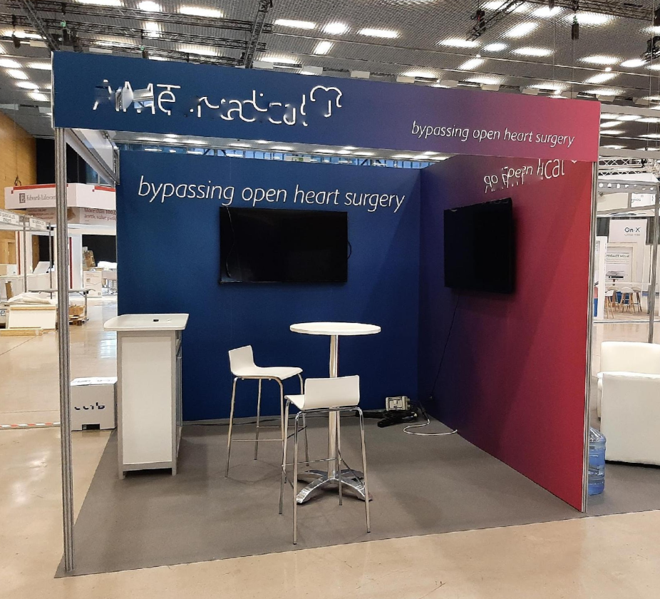
Exhibition Opportunities: The WGIC Garden
2. Garden MEDIUM (Standard Stand)
The best choice for market leaders seeking maximum visibility in the exhibition area.
Shell Scheme.
Final furniture to be defined.
If the company wishes, they can upgrade the basic equipment or signage included in the price. This can be checked directly with the venue and the organizers
Space: Large format exhibition stand 3 m x 3 m
Format: Fully produced "Turnkey" solution with a unified high-end design.
Included Services: LED strip lights., information desk (counter), electricity (3,3kW electrical switchboard (1 socket available), high-speed Wi-Fi, pre-inauguration cleaning.
Branding: 10cm high black lettering (20 letters included).
Dedicated space for prominent company logo and custom graphics.
Furniture: 1 meeting table and 2 bar stools.
Staff: 2 Full Congress Passes included.
Investment: €5,000

Slide 14
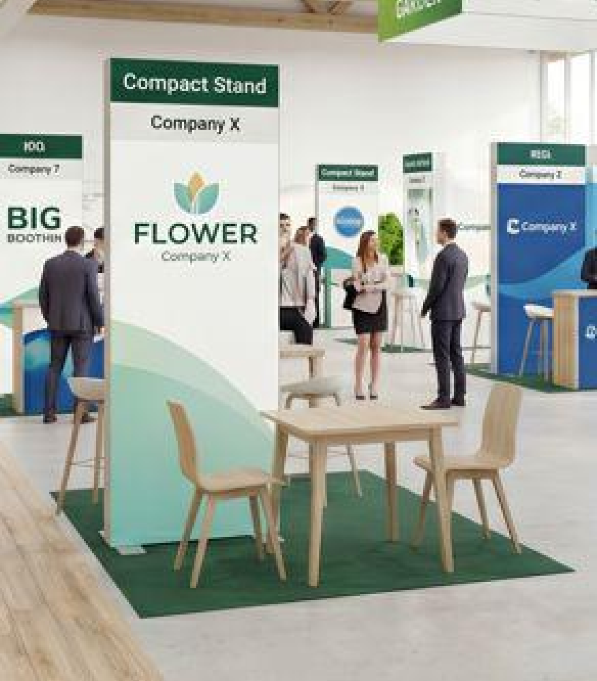
Exhibition Opportunities: The WGIC Garden
3. Flower (Compact Stand / Pod)
An efficient and cost-effective option for startups and specialized firms.
Space: Compact exhibition workstation (Stand concept TBC)
Format: Minimalist design to facilitate quick interaction.
Included Services: Electricity (1 socket) and high-speed Wi-Fi.
Branding: totem –style display (provided & printed by organization)
Furniture: 1 table and 2 chairs or bar stools.
Staff: 1 Full Congress Pass included.
Investment: €3,000
Indicative rendering. Final format to be defined.

Slide 15

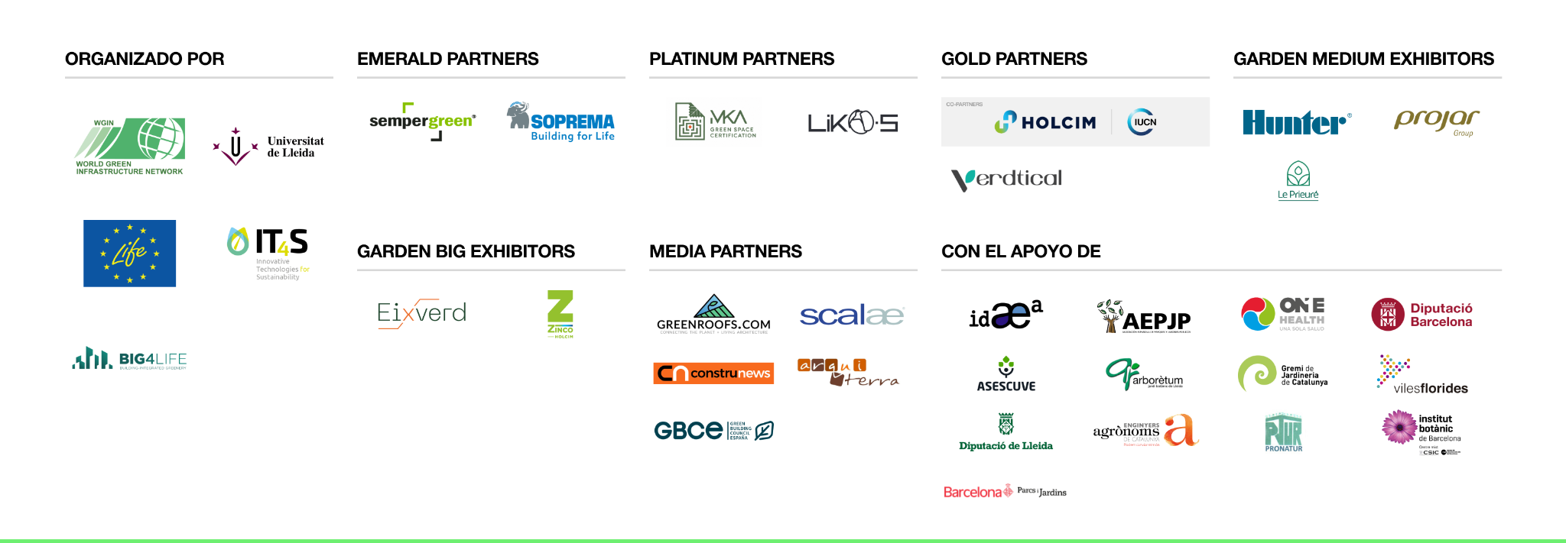
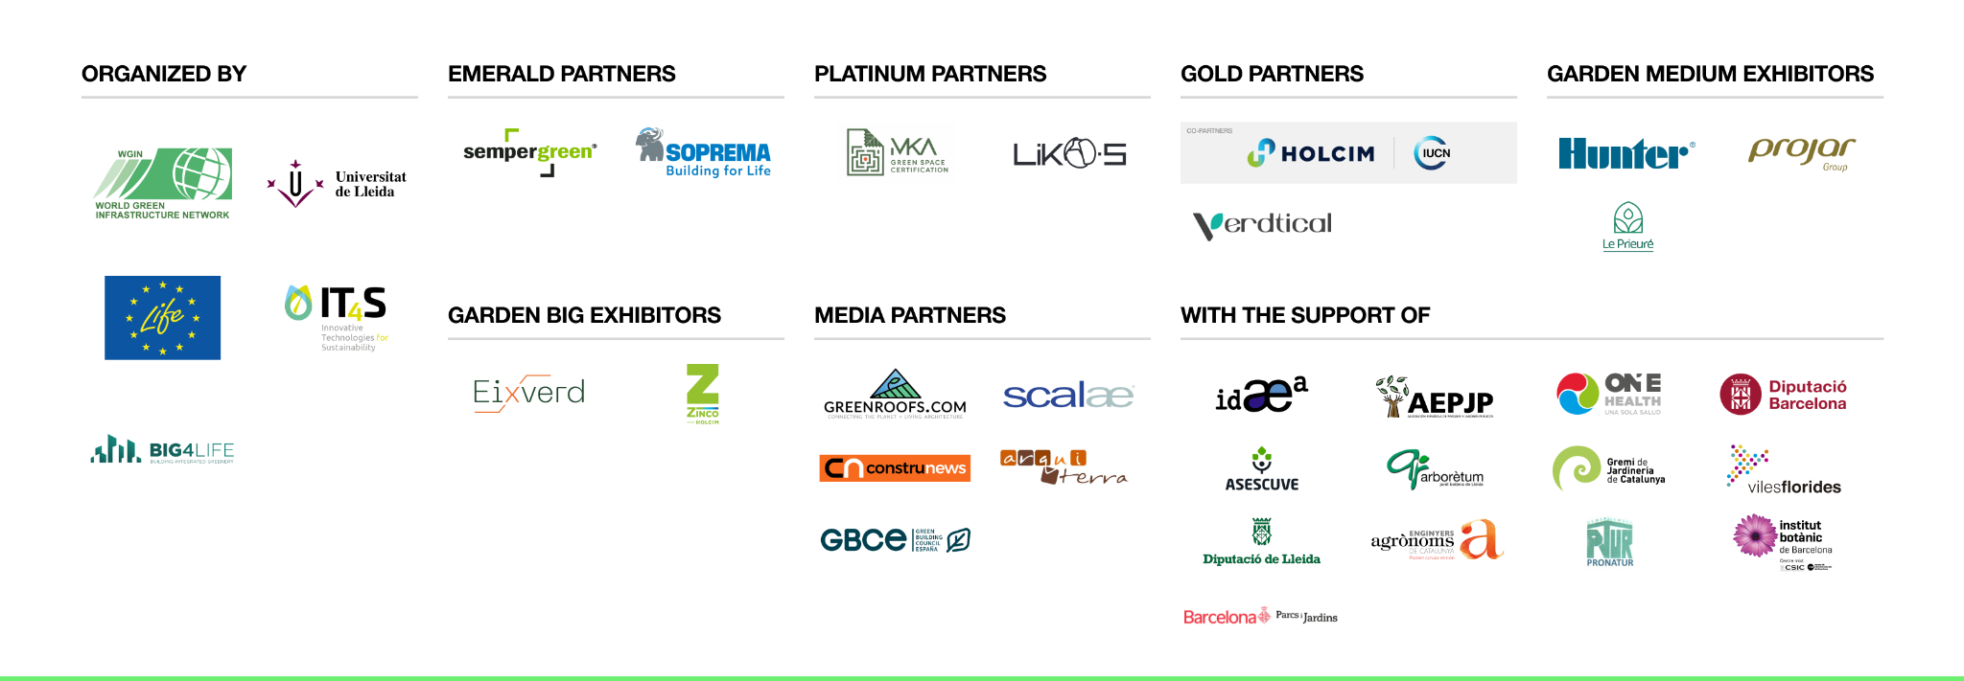
Join the Leaders already committed to WGIC26

Slide 16
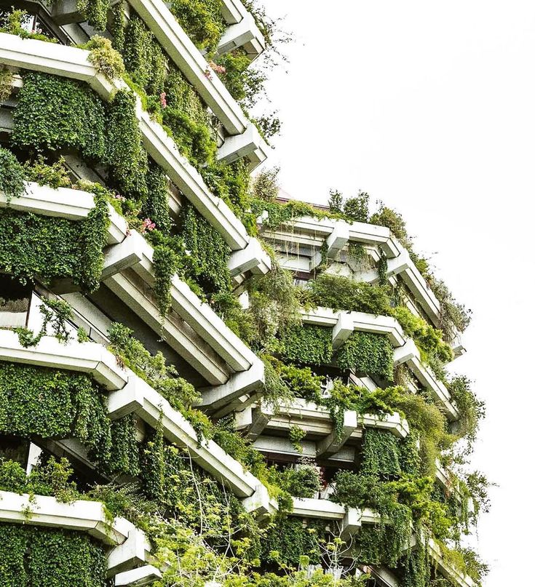
Join the global community shaping the future of sustainable cities.
Contact WGIC 2026 Sponsorship Team
sponsorship@wgic26.org
+34 623 04 90 22
World Green Infrastructure Congress 2026 Barcelona/Lleida
October 27-30, 2026
wgic26.barcelona

